Slide 1
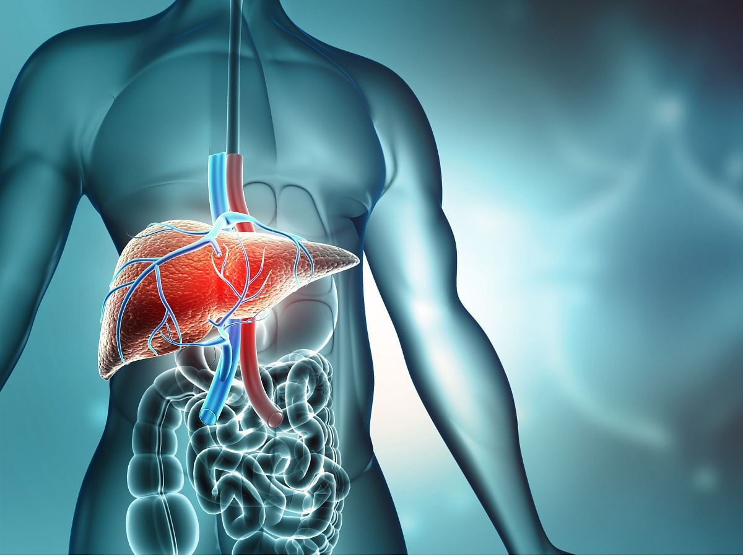
A COMPARITIVE ANALYSIS ON CIRRHOSIS (LIVER DISEASE PREDICTION USING SUPERVISED MACHINE LEARNING ALGORITHMS
Assigned By
G. Aravind Reddy
Presented By
Akhila Anapa
Divya Nayana

Slide 2
ABSTRACT
Cirrhosis is a global health issue, affecting millions of individuals, and is primarily caused by chronic liver damage from conditions such as hepatitis and excessive alcohol consumption. Around 1.5 billion people worldwide are impacted by liver diseases, with cirrhosis being a leading cause of liver-related mortality. This classification study utilizes a dataset of 418 rows and 20 columns to predict disease outcomes, specifically whether a patient will die (D), survive (C), or require a liver transplant (CL), using supervised machine learning algorithms. Clinical features such as bilirubin, prothrombin, albumin, copper levels, age, and ndays played key roles in determining outcomes. Logistic Regression and Decision Tree models were selected for their high predictive accuracy in classifying patient outcomes. Effective prediction can lead to better clinical interventions and improved patient survival rates.
Keywords: Cirrhosis, liver disease, logistic regression, decision tree, supervised machine learning models, Features.

Slide 3
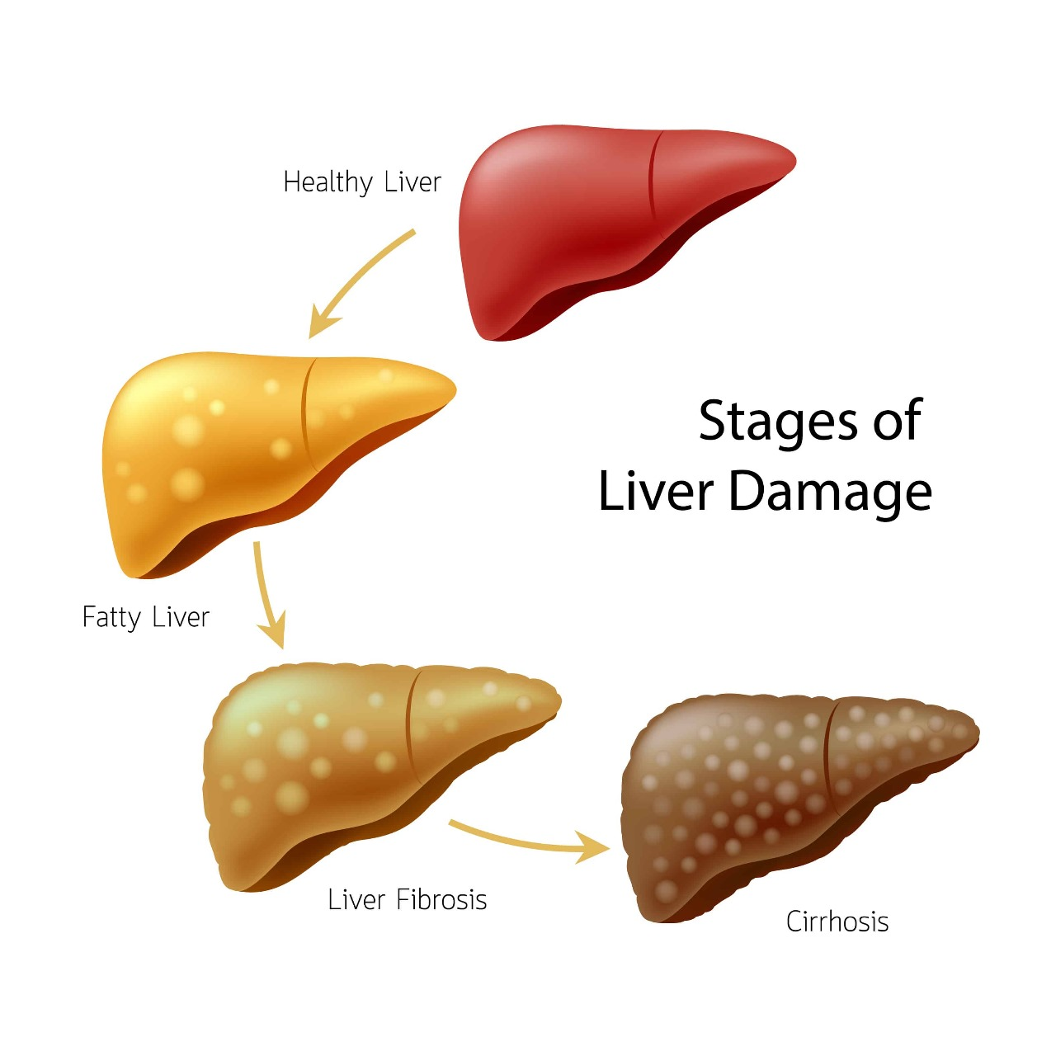
INTRODUCTION
The liver, the largest organ in the human body, plays a vital role in digestion and detoxification, filtering out harmful substances from the bloodstream. However, chronic exposure to alcohol, viral infections such as hepatitis, and other factors can lead to severe liver conditions, including cirrhosis, liver tumors, and liver cancer. Cirrhosis, a late-stage liver disease, is one of the leading causes of liver-related deaths globally, with approximately 2 million deaths per year attributed to liver diseases. In 2010 alone, cirrhosis caused around 1 million deaths, and millions more suffered from liver cancer, according to the Global Burden of Disease (GBD) project.
With the increasing global burden of liver disease, the application of machine learning in predicting and diagnosing such conditions has gained momentum. Machine learning techniques offer promising improvements in the detection and classification of liver diseases, making healthcare decisions more objective and cost-effective. In this study, we utilize various supervised machine learning techniques—Logistic Regression (LR), Decision Trees (DT), Support Vector Machines (SVM), Naive Bayes (NB), and Random Forests (RF)—to predict liver disease outcomes. The models' performances are evaluated based on accuracy, precision, recall, and F1 score, aiming to enhance early detection and improve patient management.

Slide 4
METHODOLOGY
The proposed methodology for the liver disease classification system involves multiple key steps, beginning with data preprocessing. Missing values in critical features such as bilirubin, albumin, and others were handled through interpolation, ensuring that gaps were filled without removing essential features. The 'id' column, irrelevant to the classification, was excluded. After preprocessing, the data was split into training and testing sets. Next, model training involved applying machine learning algorithms, such as Logistic Regression and Decision Trees, which were selected based on their ability to handle multi-class classification for liver disease outcomes (dead, survival, or liver transplant). During model selection, evaluation metrics like accuracy, precision, recall, F1-score, and ROC-AUC were computed to determine the best-performing model. Finally, the most accurate models were fine-tuned for predictive efficiency to assist in better clinical decision-making for cirrhosis patients.

Slide 5
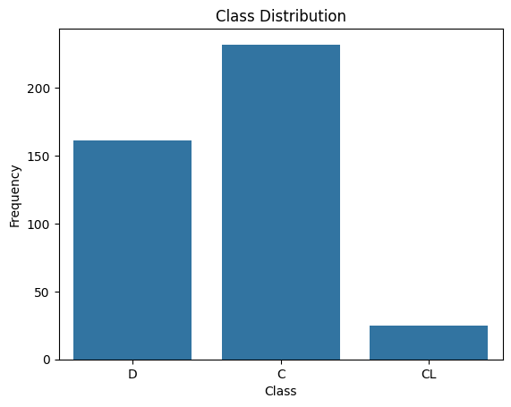
EXPLORATORY DATA ANALYSIS
Missing values in the dataset were identified and addressed.
Numerical columns with missing values were filled using interpolation to preserve data continuity.
Categorical columns had their missing values filled using the mode (most frequent value).
The 'ID' column was removed as it did not contribute to the analysis.
Distribution of numerical features was inspected using visualizations like histograms and KDE plots.
Relationships between numerical features were explored using scatterplots and pair plots.
Outliers were detected in numerical features using boxplots and the interquartile range (IQR) method.
Outliers were handled by either removing them or adjusting values to minimize their effect.
Categorical variables, especially the 'Status' column, were encoded using Label Encoding.
A correlation heatmap was used to assess relationships between numerical variables.

Slide 6
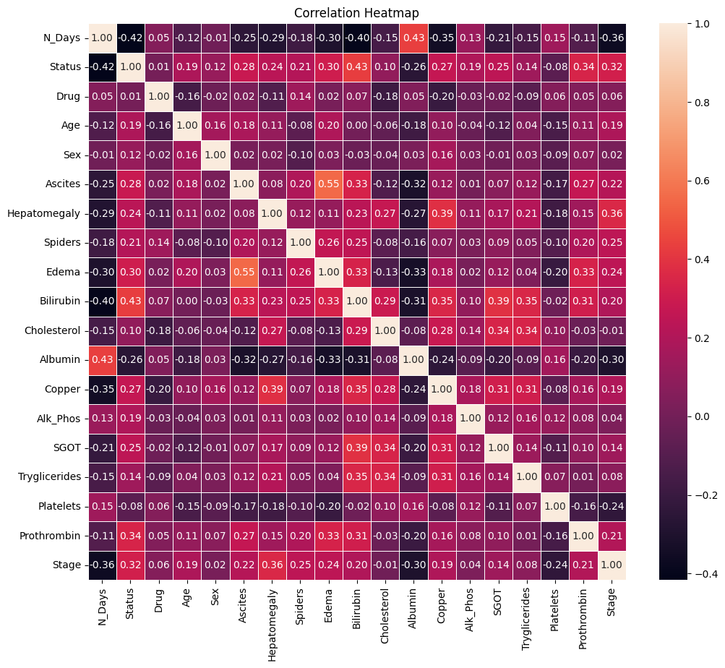
EXPLORATORY DATA ANALYSIS
The 'Status' column was found to be imbalanced across classes ('D', 'C', 'CL').
SMOTE was applied to balance the dataset, especially focusing on the minority class 'CL'.
The new class distributions were visualized using bar plots to confirm the balance after SMOTE.
A correlation heatmap highlighted strong relationships between certain features and the target.
Data scaling was applied to numerical features to ensure uniformity in magnitudes.
The cleaned and processed dataset was split into training and testing sets for model building.
EDA helped in identifying key predictors and balancing the target variable.
The final dataset was ready for machine learning, having been cleaned, imbalanced data addressed, and outliers removed.

Slide 7
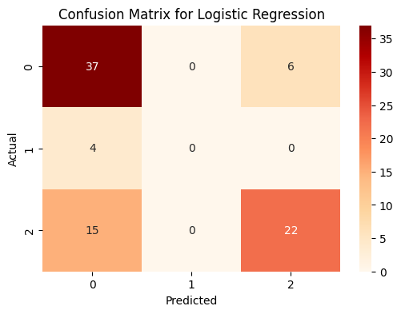
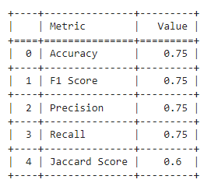
ACCURACY PREDICTION
1.LOGISTIC REGREESSION
Logistic Regression has proven to be useful in predicting cirrhosis outcomes due to its simplicity and ability to model binary and multiclass classification problems, such as patient outcomes in the cirrhosis dataset. In your case, it accurately distinguishes between survival (C), death (D), and liver transplant (CL), with an accuracy of 75%, as seen in the confusion matrix and evaluation metrics. The algorithm relies on clinical biomarkers like bilirubin, albumin, and age to make its predictions, which can help in identifying high-risk patients. The performance scores such as F1, Precision, Recall, and Jaccard Index also indicate that Logistic Regression can provide a solid foundation for cirrhosis outcome prediction, though there may still be room for improvement in handling class imbalances.

Slide 8
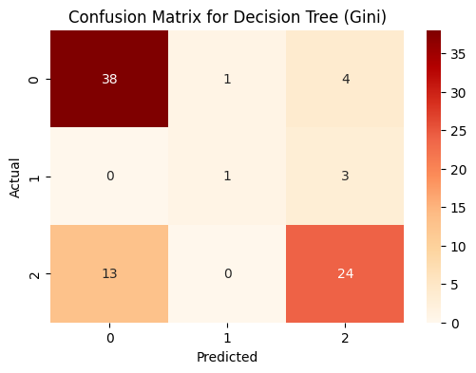
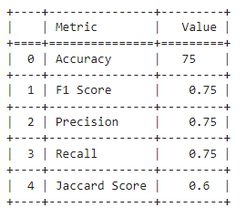
2.DECISION TREE
The decision tree has a structured flow based on key clinical features such as bilirubin, prothrombin, and albumin levels, making it interpretable for medical professionals. With a balanced accuracy score, it effectively handles class imbalances after applying techniques like SMOTE. However, certain classes like "CL" might still suffer from misclassification due to their under-representation. The decision tree's performance in terms of precision, recall, and F1-score shows that while it captures some important relationships in the dataset, there is still room for improvement in handling minority classes better than Logistic Regression.

Slide 9
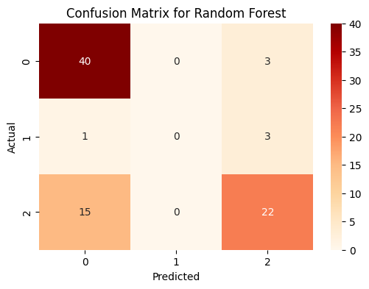
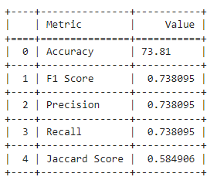
3.RANDOM FOREST
The model demonstrated high accuracy due to the ensemble of multiple decision trees, providing better generalization than individual models. It performed well on imbalanced data, with notable improvement in precision and recall for minority classes like CL. Random forest also highlighted key clinical features like bilirubin and age in making predictions, offering robust performance for this classification task. Its ability to capture complex patterns makes it highly suitable for cirrhosis outcome prediction.
The Random Forest model, along with Logistic Regression and Decision Tree, played a significant role in predicting cirrhosis outcomes based on patient data. After comparing these three models, Logistic Regression emerged as the best-performing algorithm with the highest accuracy, making it the most reliable for cirrhosis disease prediction in this dataset. These models collectively enhance the potential for early intervention and improved patient management.

Slide 10
APPLICATIONS
1.Helps doctors find patients at high risk for cirrhosis early so they can take action quickly.
2. Sorts patients into different risk levels (low, medium, high) for better care plans.
3. Aids hospitals in using their resources more effectively based on predicted needs.
4. Useful for research to uncover trends in how cirrhosis develops and responds to treatment.
5. Offers personalized health risk information to help patients manage their own health.
6. Can connect with patient records to keep track of health changes over time.
FUTURE SCOPE
1.Future work can explore a larger dataset that includes diverse populations and additional factors to improve prediction accuracy for cirrhosis.
2.Integrating the prediction model into mobile applications to allow patients to monitor their health in real time.
3.Exploring the use of artificial intelligence to enhance predictive analytics in cirrhosis treatment options and outcomes.
4.Training healthcare professionals to understand and utilize machine learning tools effectively in their practice.
5.Developing educational programs to raise awareness about cirrhosis and the role of predictive analytics in prevention and management.

Slide 11
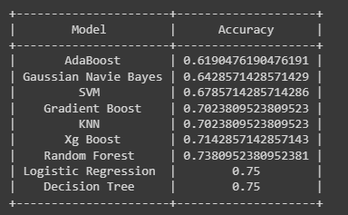
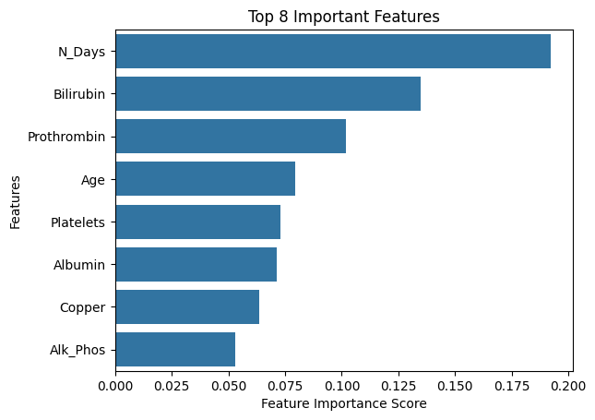
CONCLUSION
The analysis indicates that the top five attributes—bilirubin, prothrombin, albumin, copper, and age—are crucial for predicting cirrhosis outcomes. Logistic Regression and Decision Tree models emerged as the primary algorithms for effective prediction. This Effective prediction can lead to better clinical interventions and improved patient survival rates.
REFERENCES
[1] Intelligent model to predict early liver disease using machine learning technique.TM Ghazal, AU Rehman, M Saleem, 2022
[2] Prediction of fatty liver disease using machine learning algorithms. CC Wu, WC Yeh, WD Hsu, MM Islam, 2019
[3] Prognosis of liver disease: Using Machine Learning algorithms. VJ Gogi, MN Vijayalakshmi 2018

Slide 12


